Slide 1
Capstone Project

Slide 2


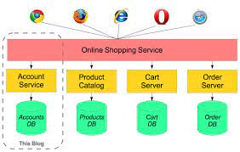



Technology used
Java Core
Java Spring Boot
Java Microservices Architecture.
Oracle/MySQL Database

Slide 3

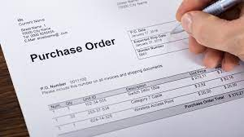
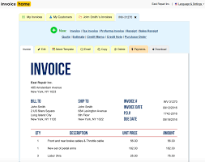

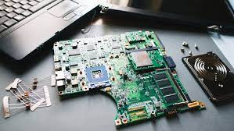

Application Modules
User Management
Customer
Items
Purchase Order
Invoice
Notification
Reports

Slide 4

Technical Workflow
Customer
API GATEWAY
PO
Database
INVOICES
Notification
Eureka Service Discovery

Slide 5
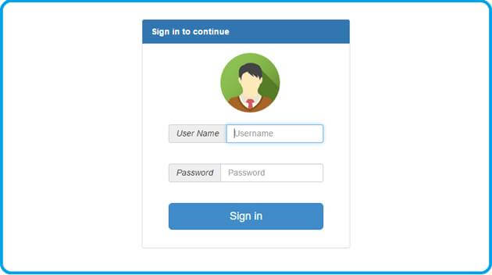
Application Flow
User Login Form
Customer CRUD
|
Place an Order
|
PO created
|
Invoice Creation
|
Customer Notified
|
Reports
Database

Slide 6
User Management
In this module users are created and managed by Admin.
Admin user can add/modify/delete the users whereas regular user can’t perform these activities but can enter to website.
User
Admin
Regular User

Slide 7
Customer
Customer is a Db Entity who can place the order.
Customer information is stored in respective Customer Tables.
Customer’s Add/Delete/Update operations can be done on Web portal.
Customer entity is further linked with other entities like PO,Invoices,Reports etc.

Slide 8
Order
Once Customer placed an order that should be recorded in Order table.
On the basis of Order, Customer’s Purchase order is to be created.
Once the order is created then a notification should be sent to notified users.

Slide 9
Purchase Order
Once the Order is placed then a PO is created for customer
Customer must accept the PO with in 5 days otherwise PO is cancelled.
Once PO is created then next step is to create the invoice based on this PO.

Slide 10
Invoice
Based on PO an Invoice is generated for Customer.
Invoice is created based on PO.
Qty of items and their unit price and Taxes are the parts of Invoice.
Invoice payment is due in 30 days.
If customer does not pay the invoice amt with in 30 days then a notification alert is to be sent to the customer.

Slide 11
Reports
Customer Invoice wise reports
Customer Item wise reports.
Item Category wise reports
PO Reports customer wise

